Slide 1






2020 Millage Rate Hearing
Agenda
Timeline
Overview
Process
History and Comparable Districts
Appendix
Engage. Inspire. Prepare.
July 14, 2020 ^{(8:00am)} | July 14, 2020 ^{(6:00pm)} | July 28, 2020 ^{(8:00am)}
Version 3.0
Notes:
Previous hearings are online.

Slide 2
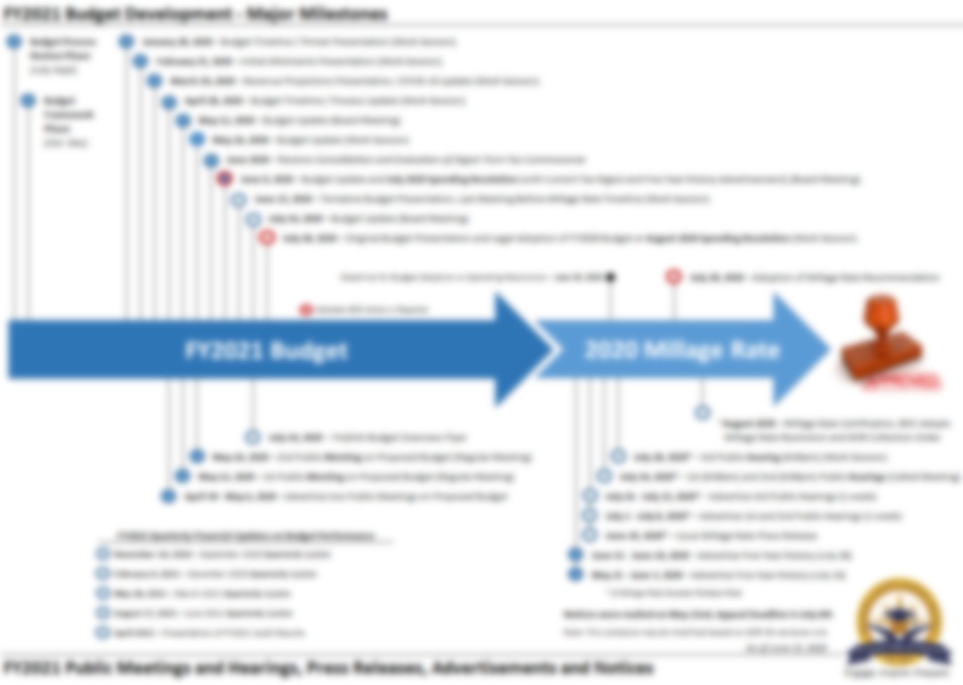
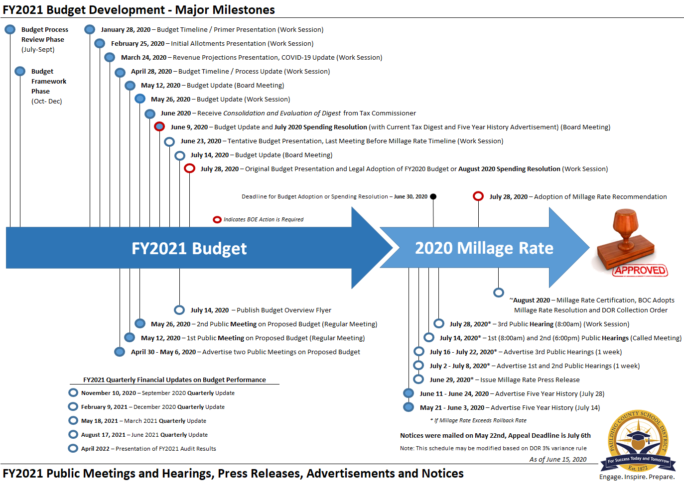
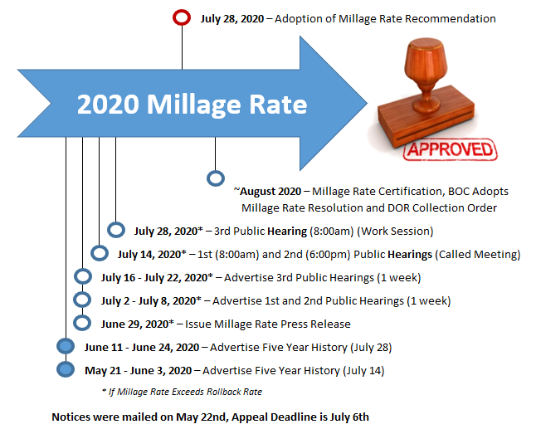
2020 (FY21) Millage Rate Timeline
1 | Timeline

Slide 3
Millage Rate Overview
Engage. Inspire. Prepare.

Slide 4
2020 Millage Rate Overview
  Maintenance & Operations (M&O) millage rate of 18.750 was utilized for advertisements and the Tentative FY2021 Budget. An M&O millage rate of 18.750 was included in the Original FY2021 Budget – but may be amended.
  Bond millage rate of 0.000 will be maintained in the FY2021 Budget, with bond principal and interest paid through E-SPLOST. A bond millage of approximately 1.682 would be required to meet FY2021 debt service.
All information presented is based on the most current digest available.
Net M&O Digest is projected to increase $348m or 7.8% to $4.8 billion.
Changes in assessed property values (reassessment) will increase 2020 property taxes by an average 7.4% (18.750).
Other changes to the digest will increase 2020 property taxes by 0.4%.
Net Taxes or levy will increase 7.8% (18.750).
COVID-19
  Assessed Values are as of January 1st
  Waived penalties and interest on past due taxes (BOC Resolution, 3/30/20)
  Extended deadline for homestead applications (BOC Resolution, 6/3/20)
2 | Overview
Notes:
*March 15, 2020 through December 31, 2020 deadlines (applications through 12/31
“We will be mailing 65,689 real property notices and 2,234 personal property notices on May 22 allowing a 45-day appeal period which will end July 6. The Board of Assessors and Board of Commissioners has also agreed to insert information listed below in the notice addressing concerns over the COVI-19 pandemic as we fully expect increased call and appeals.”
Net M&O Digest is projected to increase $348m or 7.8% to $4.8 billion for 2020, compared to $387m or 9.5% in 2019
Changes in assessed property values (reassessment) will increase 2020 property taxes by an average 7.4% - 2019 was 7.9%
Other changes to the digest will increase 2020 property taxes by 0.4% - 2019 was 0.9%

Slide 5
Millage Rate Process
Engage. Inspire. Prepare.

Slide 6
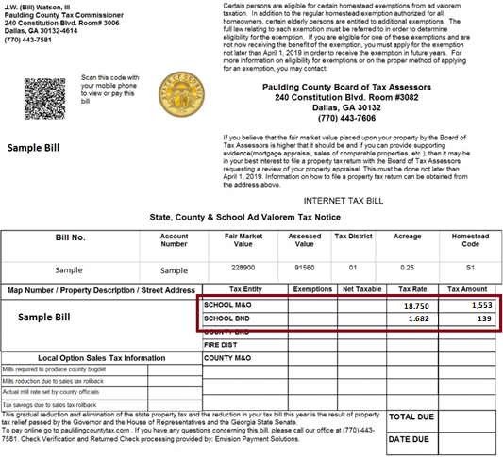
Millage Rate Types
Millage Rate Types.
Maintenance and Operations (M&O)
Bond
Bond Millage Rate.
In FY2011 the district eliminated the bond millage rate, which was 2.963 (2010). Debt Service (principle and interest) shifted from a property tax millage to a sales tax – essentially removing the tax burden from property owners and shifting the cost to purchasers of certain goods and services in Paulding County (resident or not). A bond millage of approximately 1.682 would be required to meet FY2021 debt service.
Bond Millage Rate Example
With a bond millage rate of 1.682 (2020), this person’s tax bill would increase $139 annually without SPLOST.
3 | Process

Slide 7
Property Taxpayer's Bill of Rights
Property Taxpayer's Bill of Rights
Senate Bill 177, Act 431 was signed April 30, 1999 and became effective January 1, 2000 (O.C.G.A. 48-5-32.1). The bill has two main thrusts:
Prevention of indirect tax increases resulting from increases to existing property values due to inflation,
Enhancement of an individual property owner's rights when objecting to and appealing an increase made by a county board of tax assessors to the value of the owner's property.
Rollback of Millage Rate When Digest Value Increased by Reassessments
The Revenue Commissioner developed rules and regulations to implement the terms and provisions of O.C.G.A. 48-5-32.1.
Prevention of Indirect Tax Increases: Each year there are two types of value increases made to a county tax digest;
increases due to inflation, and
increases due to new or improved properties.
There are no additional requirements if the levying (or recommending) authority rolls back the millage rate each year to offset any inflationary increases in the digest.
3 | Process
Notes:
That Georgia Law is referred to the Property Taxpayer’s Bill of Rights and I have included a summary provided by the Department of Revenue in the presentation. Again, for our purposes the law attempts to address increases to existing property values due to inflation.

Slide 8
Property Taxpayer's Bill of Rights
Rollback of Millage Rate to Offset Inflationary Increases: When the total digest of taxable property is prepared, Georgia Law requires that a rollback millage rate must be computed that will produce the same total revenue on the current year's new digest that last year's millage rate would have produced had no reassessments occurred.
If the county (school district) elects to set their millage rate higher than the rollback rate, they will be required:
Notification of Tax Increase With Three Public Hearings: The levying (or recommending) authority must hold three public hearings allowing the public input into the proposed increase in taxes.
Publish Notice in Paper One Week Before Each Hearing: The levying (or recommending) authority must publish a notice in the paper one week in advance of each of these three public hearings.
Press Release to Explain Tax Increase: The levying (or recommending) authority must issue a release to the press explaining its intent to increase the taxes.
Georgia Department of Revenue: Local Government Services Division
https://dor.georgia.gov/property-taxpayers-bill-rights#rollback, May 28, 2019
3 | Process
Notes:
….It requires the District to calculate a rollback rate and (if our millage rate is higher than the rollback rate) to hold three public meetings, publish notices in the paper and issue a press release.

Slide 9
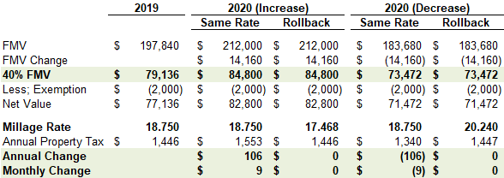
2020 Press Release and Rollback Example
“Each year, the Paulding County Board of Tax Assessors is required to review the assessed value for property tax purposes of taxable property in the county. When the trend of prices on properties that have recently sold in the county indicate there has been an increase in the fair market value of any specific property, the Board of Tax Assessors is required by Georgia law to re-determine the value of such property and increase the assessment. This is called a reassessment. If you have questions or concerns regarding your assessed value, please contact the Board of Tax Assessors. The deadline to appeal your 2020 assessed value is July 6, 2020.
Rollback Example
When the total digest of taxable property is prepared, Georgia Law requires that a rollback millage rate must be computed that will produce the same total revenue on the current year’s new digest that last year’s millage rate would have produced had no reassessments occurred.”
June 29, 2020 PCSD Press Release
7% increase in FMV equals a rollback rate of 17.468, anything higher would be considered a tax increase or "not revenue neutral".
7% decrease in FMV equals a rollback rate of 20.240, anything higher would be considered a tax increase or "not revenue neutral".
3 | Process
Notes:
The Paulding County Board of Assessors – which is a completely separate entity from the District – is required by Georgia law to reassess taxable property. Simply put – that process may result is a tax payer’s property value Decreasing, which means their property taxes will Decrease. Or, the process may result is a tax payer’s property value Increasing, which means their property taxes will Increase. It is important to note, however, that in either scenario the District’s millage rate is the same and has NOT changed.
For our part, Georgia law requires we compute a millage rate that will produce the same revenue on the new digest, had no reassessments occurred – essentially, to calculate a rate (a rollback rate) that neutralizes the reassessments.

Slide 10
Millage Rate History and Comparable Districts
Engage. Inspire. Prepare.

Slide 11
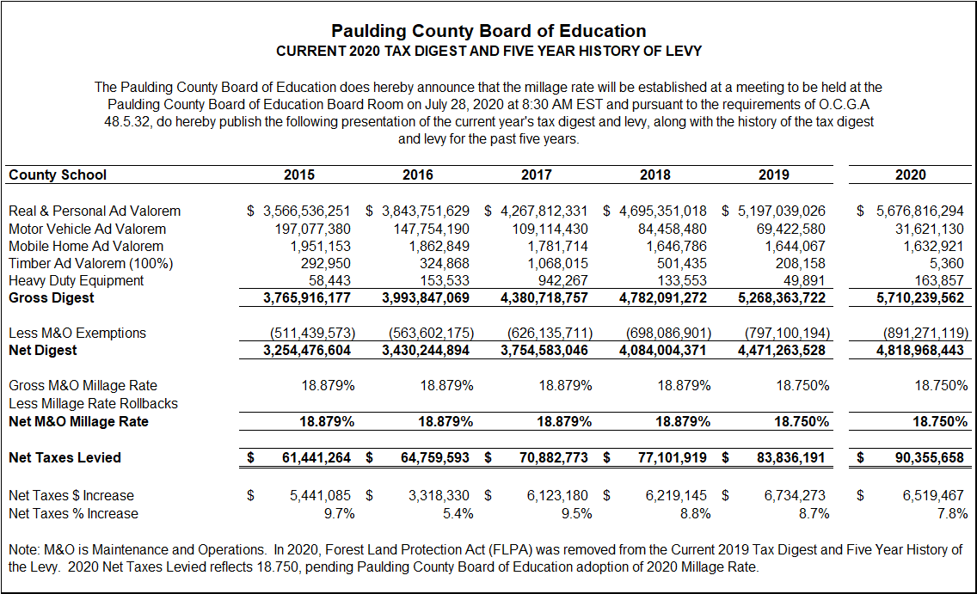
Current and Five-year History
Reflects the Consolidation & Evaluation of Digest 2020, dated May 20, 2020
4 | History

Slide 12
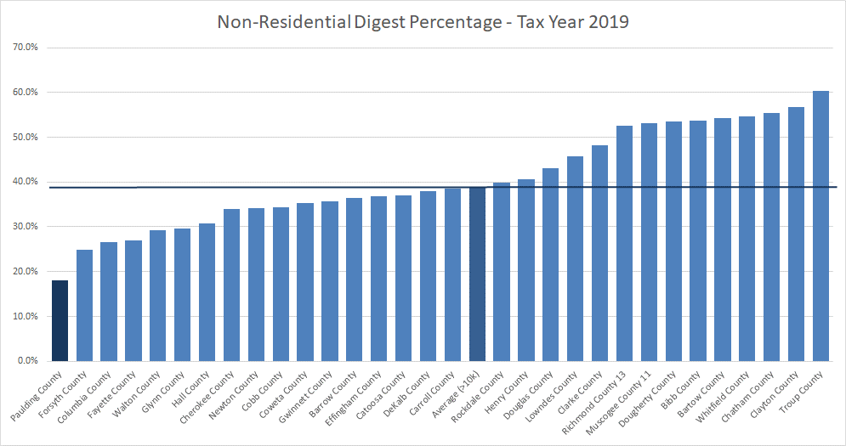
Local Revenue: Property Tax
Note: Projections as of 5.8.20 unless otherwise noted
4 | Comparable Districts

Slide 13
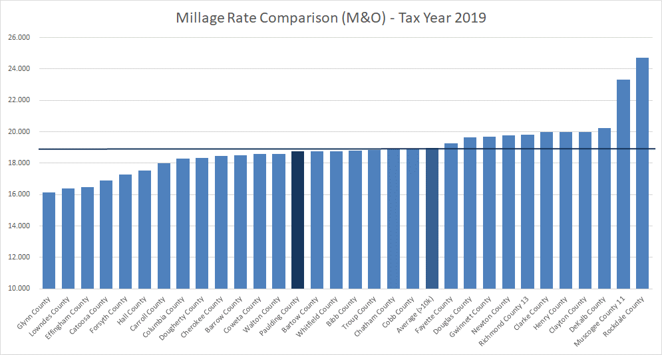
Local Revenue: Property Tax
Note: Projections as of 5.8.20 unless otherwise noted
4 | Comparable Districts

Slide 14
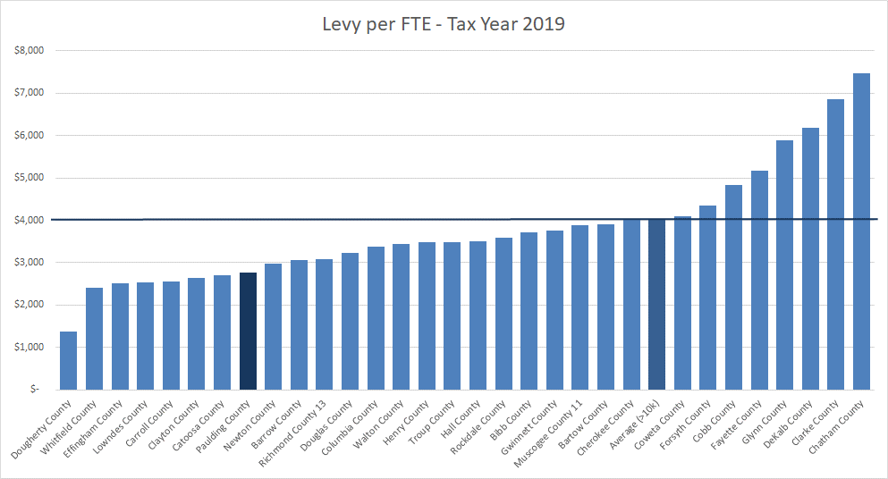
Local Revenue: Property Tax
Note: Projections as of 5.8.20 unless otherwise noted
4 | Comparable Districts

Slide 15
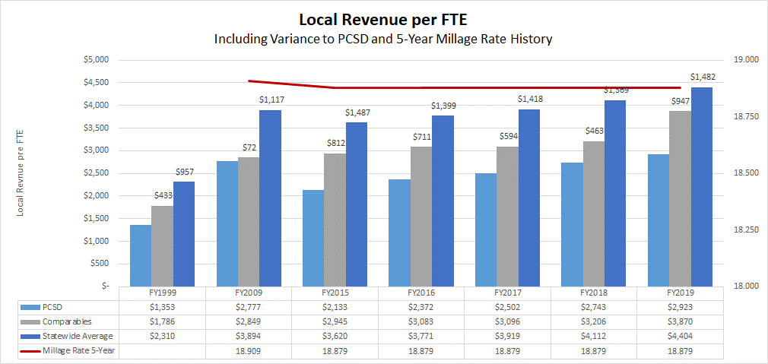
Historical Local per Pupil Funding
PCSD remains $486 lower in per-pupil local revenue than comparable districts or $1,482 lower than the statewide average (FY2019).
Source: GaDOE School System Revenue/Expenditures Report as of FY2019
4 | Comparable Districts

Slide 16
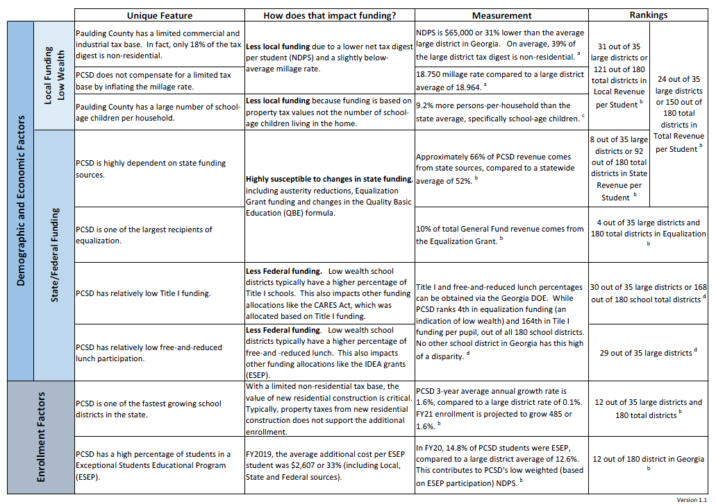
What Makes PCSD Funding Unique?
4 | Comparable Districts
Notes:
1 Home $5,000 Property Tax = $5,000 PP with 1 kid or $1,000 PP with 5 kids

Slide 17
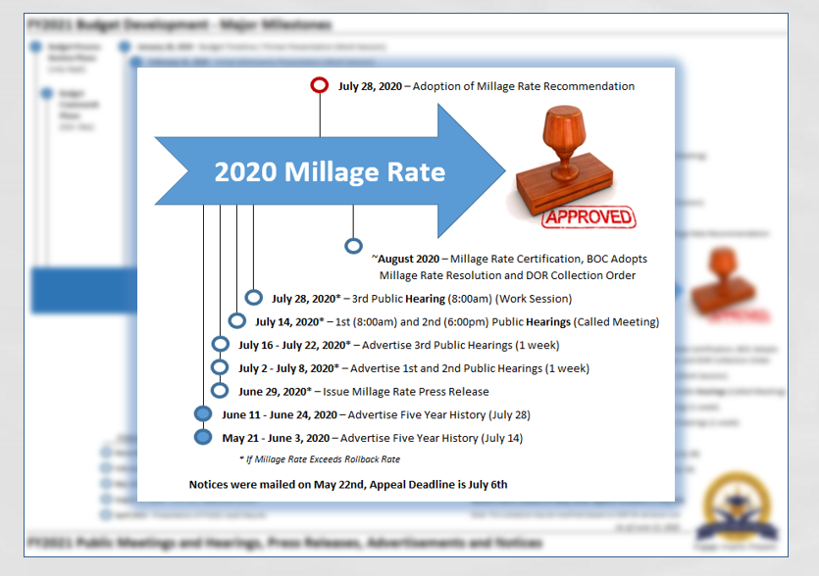
2020 (FY21) Millage Rate Timeline
1 | Timeline

Slide 18
Thank You
For Budget Ideas and Feedback
Visit our Website (Budget Feedback)
Engage. Inspire. Prepare.

Slide 19
Appendix
Engage. Inspire. Prepare.

Slide 20
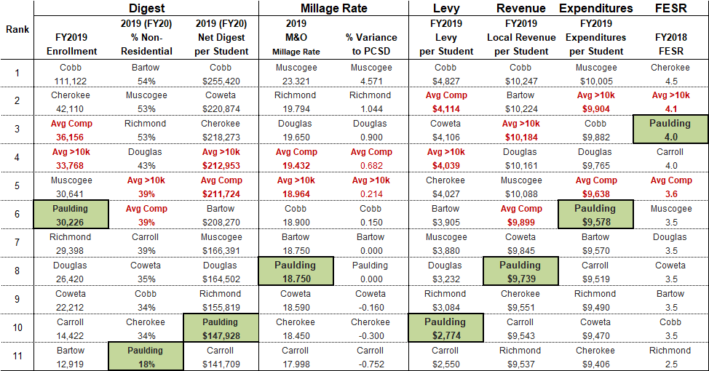
Digest, Millage and Per Pupil Comparisons
Value of Mill. For 2020, 1 mill will produce $4.8 million in revenue ($157 per pupil). Meaning, every ¼ mill produces approximately $1.2 million in revenue. To raise the Levy per Student to the Average Comparable would require 9.050 additional mills.
Appendix
Notes:
Bartow, Cobb, Douglas and Cherokee Averages:
% Non-Resi 43% – we are 20%
2018 MR 19.100 – we are 18.879

Slide 21
Tax Digest: Net Digest per Student (FY21 Primer)
Net Digest Allocation: Residential versus Non-Residential
What if Paulding County’s Digest was Similar to the Average Large District in Georgia?
Residential would need to increase 7% or $180 million
61% represents $126,300 Residential NDPS, compared to $121,200 in FY2020
Non-Residential would need to increase 207% or $2 billion
39% represents $81,800 Non-Residential NDPS, compared to $26,700 in FY2020 - an additional $55,100 per student
Source: Georgia Department of Revenue, Consolidated Tax Digest Summary - Large School Districts Average (enrollment >10,000)
Appendix

Slide 22
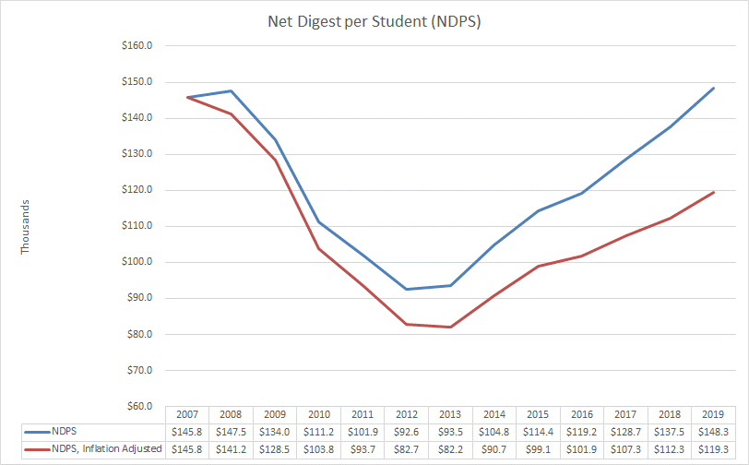
Tax Digest: Great Recession (FY21 Primer)
Great Recession. While Paulding County’s housing-centric economy is recovering from the recession, the residual inflation-adjusted effect on the tax digest remains material. This is significant to note because approximately one-third of the District’s revenues comes from local sources.
Between fiscal years 2009 and 2014, the net digest decreased by 36% or $1.5 billion
FY2020 net digest per student (NDPS) remains 18% lower than FY2009, inflation adjusted
Source: Bureau of Labor Statistics, CPI Calculator (measured in January, annually) and Georgia Department of Revenue, Consolidated Tax Digest Summary
Appendix

